Slide 1


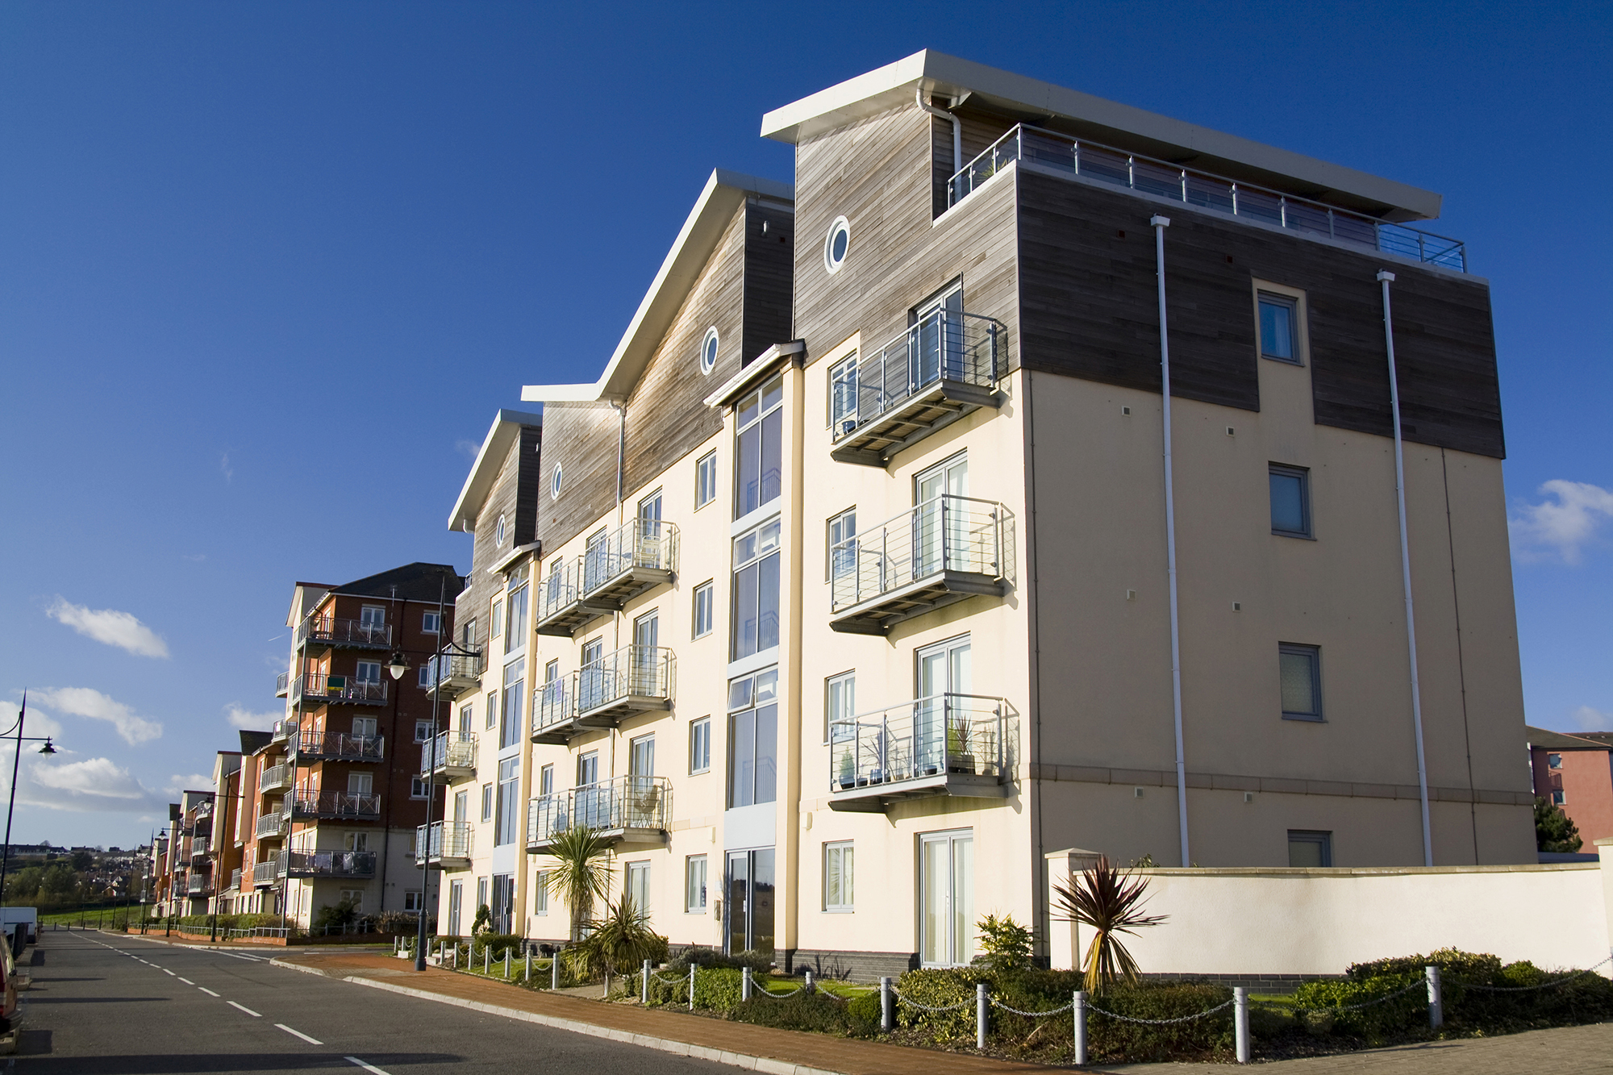

Now on HomeWriter
How to activate U-Sure on the platform and obtain quotations - guide

Slide 2

Activating our Product
  From main menu select Homewriter edi
  Then select Insurer Control
  Enter scheme code - LEUN
  Press F2 and select the switch on Insurer option
  Contact U-Sure who will provide your U-Sure Agency Number along with a verify code once partial key has been provided

Slide 3

Obtaining an unoccupied quotation
U-Sure specialise in Unoccupied property and occupied property owners, with A rated Capacity.
Unoccupied cover available for residential properties...
Bronze cover – FLEA
Silver Cover – FLEA including Storm and Flood
Gold – Full Peril cover
Simple choose the following occupancies to obtain an unoccupied property quote
GOLD must be – owned outright by proposer sharing (under accommodation list)
Silver must be – owned sometimes let furnished (under accommodation list)
Bronze must be – owned sometimes let unfurnished (under accommodation list)
Once P.O.S documentation has been created, they will reflect the correct cover type and endorsements for onward transmission to the client.
Now available on

Slide 4
A couple of pointers
  Property must be self contained (under security)
  Brokers must be activated by U-Sure to quote and bind cover – activation process document to follow. Allocate same Agent number as we have issued on schemeserve.
  Residence must = Non occupant
  Referral underwriting must be entered to change premium and or Endorsements on the Policy
  Override code must be obtained from U-SURE to bind cover
  Policy number must be allocated by U-Sure
  Agent to amend back office record to show the premium matches that of the schedule issued
  Policy wording to be issued by U-Sure to the Agent once policy is bound. Or available online

Slide 5
We look forward to working with you
  Need Help?
  Call us 01633 838976
  Email OpenGI@u-sure.com
  www.u-sure.com/open-gi-homewriter

